Slide 1


Underwater Optical Communication
Semester Project
López Estepa, Pedro
Assistant: Konstantinos Karakasiliotis
Professor: Auke Jan Ijspeert
Midterm presentation
12 November 2008

Slide 2
Summary
Goals
Communication technology
Optical Experiments
Fast Optical Communication
Transmitter
Receiver
Future work
Underwater Optical Communication - Pedro López Estepa
Notes:
Only general

Slide 3
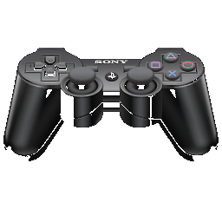

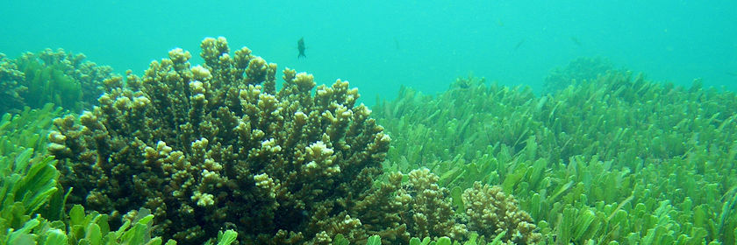
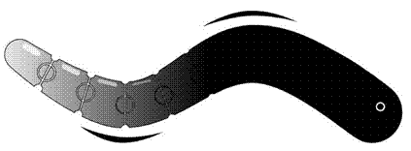
Goals
  Project Description
accompanying vehicle control
Radio
video and data
[transmitter]
[receiver]
Blue light
Underwater Optical Communication - Pedro López Estepa

Slide 4
Goals
  Goals of the Project
  Develop a communication system to transmit video between underwater robot and surface platform
  Decrease size due to space restrictions.
  Find a good combination of communication speed and robustness.
Underwater Optical Communication - Pedro López Estepa

Slide 5


Wireless Communication Technologies 31.09.2008 – 7.10.2008
  Radio Communication ¹
    High frequency radio
      Attenuation in water is extremely high
    Low frequency radio
      Attenuation is managable
      Maximum BW is limited
  Sound Communication ¹
    For acoustic single transducers the emitter can be considered omnidirectional.
    In an acoustical communication system, transmission loss is caused by energy spreading and sound absorption
      Energy spreading loss depends only on the propagation distance.
      The absorption loss increases with range and frequency. These problems set the limit on the available bandwidth.
Underwater Optical Communication - Pedro López Estepa

Slide 6
Wireless Communication Technologies 31.09.2008 – 7.10.2008
  Optical Communication
    LASER ²
      Monodirectional
    Visible Spectrum ¹ :
      Light absorption in water present a minimal value in this range
      Omnidirectional
  ^{1.} Felix Schill , Uwe R. Zimmer , and Jochen Trupf. Visible Spectrum Optical Communication and Distance Sensing For Uncerwater Applications. The Australian National University, ACT 0200.
  ^{2.} Mingsong Chen, Shengyuan Zhou, and Tiansong Li. The Implementation of PPM in Underwater Laser Communication System. Department of Communication and Information Engineering Guilin University of Electronic Technology (GUET) China and School of Communication and Information Engineering Beijing.
Underwater Optical Communication - Pedro López Estepa

Slide 7
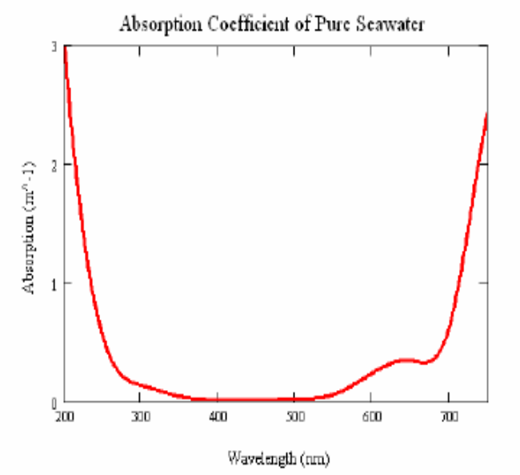
Communication technology 31.09.2008 – 7.10.2008
  Visible Range Optical Communication
  Infrared: The light absorption in water
  increases towards the red an infrared
  part of the espectrum
  Blue Light: Minimal light absorption
  in water is usually achieved for blue light
  around 400-450 nm.
Underwater Optical Communication - Pedro López Estepa

Slide 8
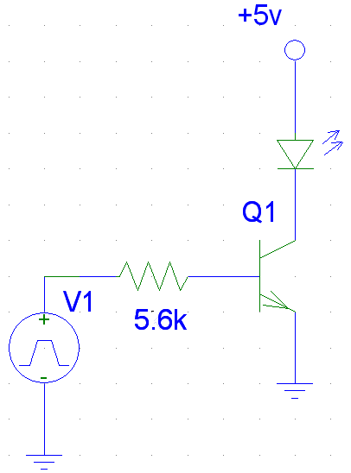
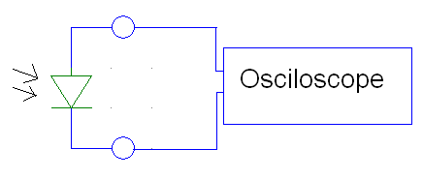
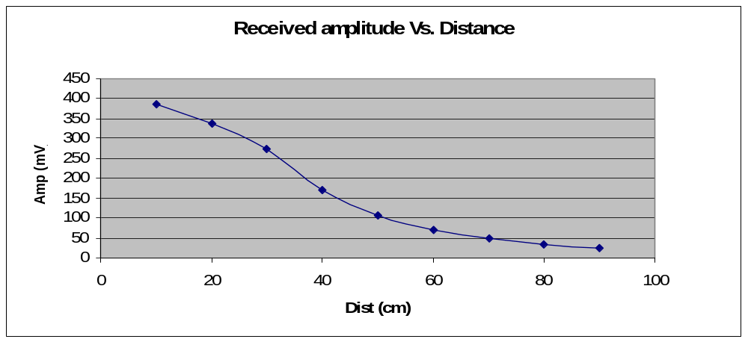
Preliminary experiments 08.10.2008 – 15.10.2008
  Initial basic design
  Transmitter Receiver
Square
Source
LED Drive
LED
Air
Other light
sources
LED Receiver
Underwater Optical Communication - Pedro López Estepa
Notes:
Instead of Received Amplitude -> Sensor Output

Slide 9
Preliminary experiments 08.10.2008 – 15.10.2008
  Conclusions
    Necessary faster LED drive
    Implement modulation
    Receiver
      Amplification
      Filtering
      Signal Analysis
Underwater Optical Communication - Pedro López Estepa

Slide 10
Fast optical communication 16.10.2008 – 29.10.2008
  Existing models 16.10.2008 – 25.10.2008
  AM Optical Transmission
    MHz-range frequency response
    The driving method is not capable of fully-driving the LED at the highest frequencies
  FM Optical Transmission
    FM modulation was chosen over AM modulation since it was viewed as being more resistant to fading and variations in the signal amplitude.
    This worked fine even though the duty cycle of the pulses was extremely short (4ns at 100kHz).
Underwater Optical Communication - Pedro López Estepa

Slide 11
Fast optical communication 16.10.2008 – 29.10.2008
  Existing models 16.10.2008 – 25.10.2008
  IrDa System
    IrDa(Infrared Data) modulation, has the advantage, that highly optimised integrated circuits are readily avaible at low price.
    Speed of only 14.4kbit/sec in range 2.7 m.
  RONJA
    Rate 10Mbps Full duplex
    BPSK modulation (as on AVI aka Manchester)
    Lens amplification
    Works under heavy rain
Underwater Optical Communication - Pedro López Estepa

Slide 12
Fast optical communication 16.10.2008 – 29.10.2008
  System Development 25.10.2008 – 29.10.2008
  The system design
    Transmiter
      RONJA fast driver
        Allowed rate (10Mbps) bigger than our need (~1Mbps)
        Easy implementation (Inverter Array)
      Manchester modulation with XOR gate
        Fast modulation (High Frequency XOR gate)
        Safe transmission
      Blue High-intensity LED source
        Great light intensity
        Fast switching speed. High emission and fast charge of LED’s capacitances.
        Small packages
Underwater Optical Communication - Pedro López Estepa

Slide 13
Fast optical communication 16.10.2008 – 29.10.2008
  System Development 25.10.2008 – 29.10.2008
  The system design
    Receiver
      Silicon Photodiode for the Visible Spectral
        Especially suitable for applications around 450 nm
        High rise and fall time
      dsPIC
        Fast, sophisticated and versatile.
        Possibility in single-chip: Amplification, Filtering, Demodulation
Underwater Optical Communication - Pedro López Estepa
Notes:
Say that this sensor is the one we have until now and that we will change it with a more selective one in the blue band.

Slide 14
Fast optical communication 16.10.2008 – 29.10.2008
  System Development 25.10.2008 – 29.10.2008
  The system design
  TX Water RX
Video signal
Modulation
XOR
LED Driver
LED
Photodiode
dsPIC
CLK
Demodulated signal
Vdd
GND
Vdd
GND
Underwater Optical Communication - Pedro López Estepa
Notes:
The video will be already processed in the FPGA so it will be easy to extract the XOR of the signal and give it as an input to the TX

Slide 15
Trasmitter 29.10.2008 – now
  Design & Build
  Design
    PCB design
    Devices
      Z-Power LED Series X10190
      Hex Inverter MC74Ho4ADR2
      XOR Gate MC74LVX86
  Build
    PCB build
    SMD Devices solding
Underwater Optical Communication - Pedro López Estepa

Slide 16
Receiver 04.10.2008 - now
  Design & Build
  Design
    PCB design
    Devices
      Silicon Photodiode for the Visible Spectral Range BPW 21
      dsPIC (Reading different model datasheets)
  Build
    PCB build
    SMD Devices solding
Underwater Optical Communication - Pedro López Estepa

Slide 17
Future work
  Improvements
  Optical filtering
  Include lens (Amplification)
  Rate Increase
  PCB Reduce
  …
Underwater Optical Communication - Pedro López Estepa

Slide 18
Time Frame
  Time description
W. Communication technologies
Communication type selection
Preliminary experiments
Complete task
Fast optical communications
Time
Incomplete task
Trasmitter design
Transmitter build
Receiver design
Receiver build
Out of water experiments
Underwater Testing
Improvements
Underwater Optical Communication - Pedro López Estepa

Slide 19

Questions
Underwater Optical Communication - Pedro López Estepa

